Slide 1
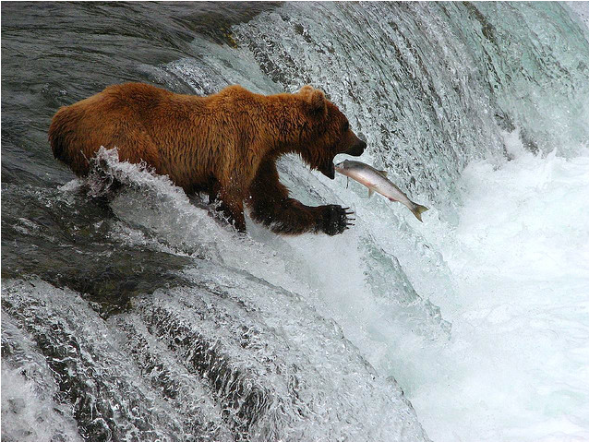
Javazone Workshop Storm Framework: Making sense of tweets
Jon Espen Ingvaldsen
Qadeer Ahmad

Slide 2
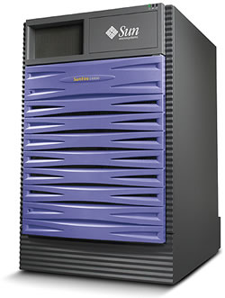


The Old Days

Slide 3





INPUT
OUTPUT

Slide 4


Slide 5





MAP
REDUCE

Slide 6
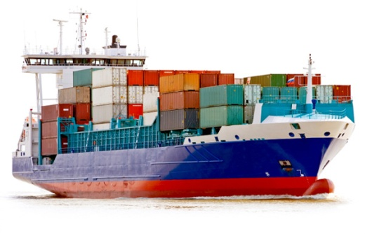

Slide 7


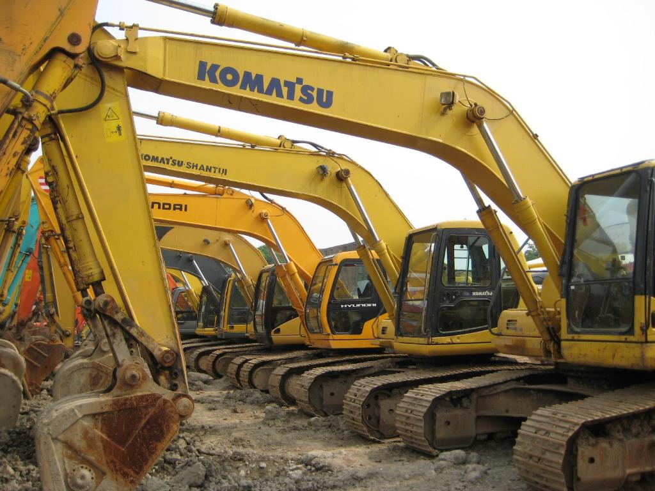


Common Big Data Architectures
MapReduce job
?
?

Slide 9
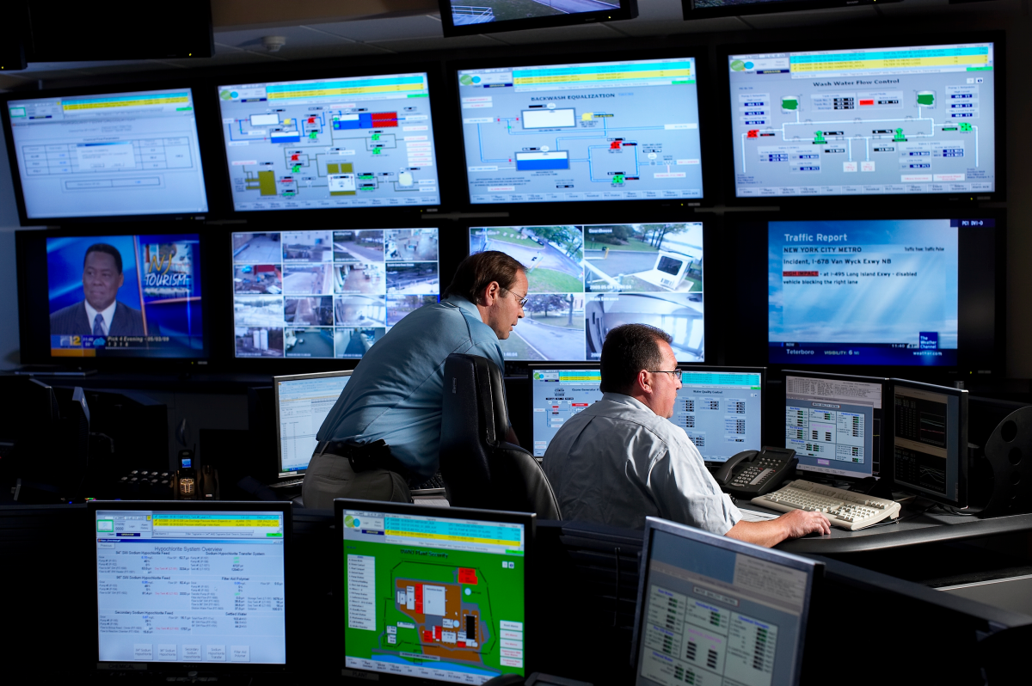


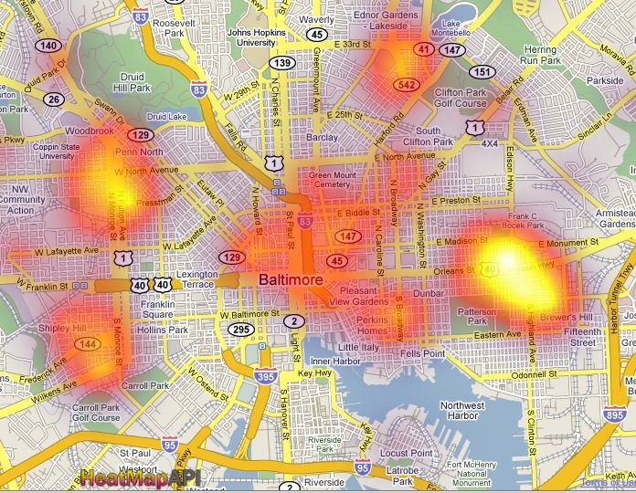
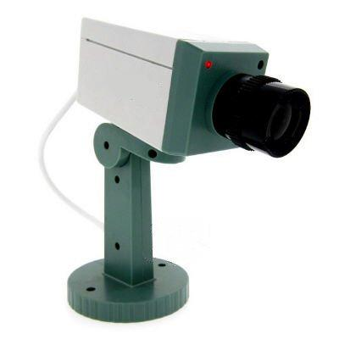

Slide 10
Storm
Distributed
Fault tolerant
Realtime computation

Slide 11
Storm – Continuous Monitoring
Storm topology
MapReduce job

Slide 12
Why use Storm?
Simple programming model.
Runs any programming language.
Fault-tolerant:
All you have to do is provide a jar containing all your code.
Storm distributes that jar, assigns workers across the cluster to execute the topology, monitors the topology, and automatically reassigns workers that go down.
Horizontally scalable: All computations are done in parallel. To scale a realtime computation, all you have to do is add more machines and Storm takes care of the rest.
Reliable: Storm guarantees that each message will be fully processed at least once. Messages will be processed exactly once as long as there are no errors.
Fast: Storm is built with speed in mind. ZeroMQ is used for the underlying message passing, and care has been taken so that messages are processed extremely quickly.

Slide 13
Key concepts…

Slide 14
Tuples
Ordered list of elements

Slide 15
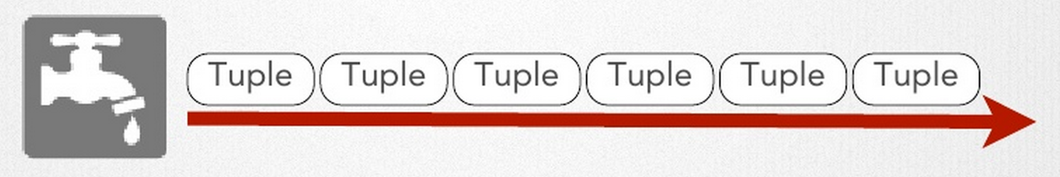
Spouts
Source of streams
Unbounded sequence of tuples
Can be:
Queues
Web logs
API calls
Event data

Slide 16
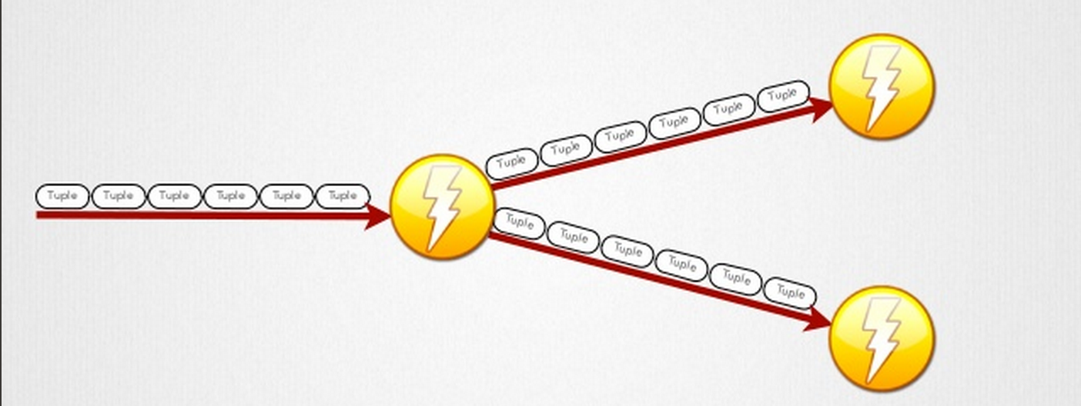
Bolts
Process tuples and create new streams
Apply functions / tranformations
Filtering
Aggregation
Access DBs, APIs, etc.

Slide 17
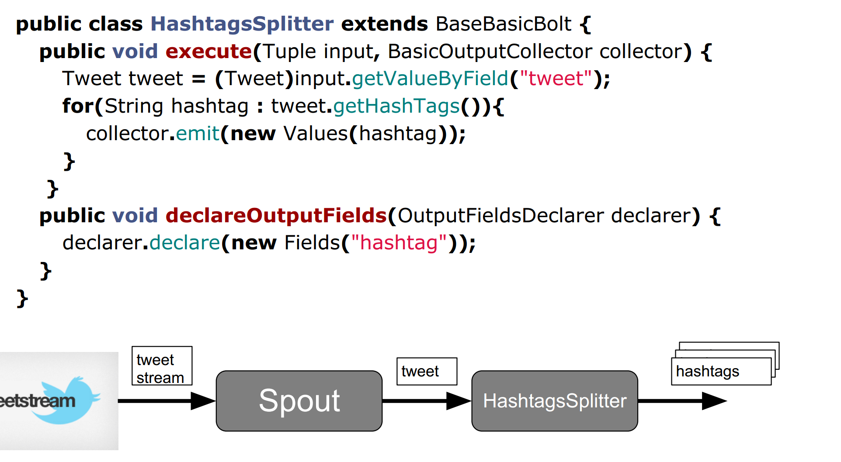
Example code

Slide 18
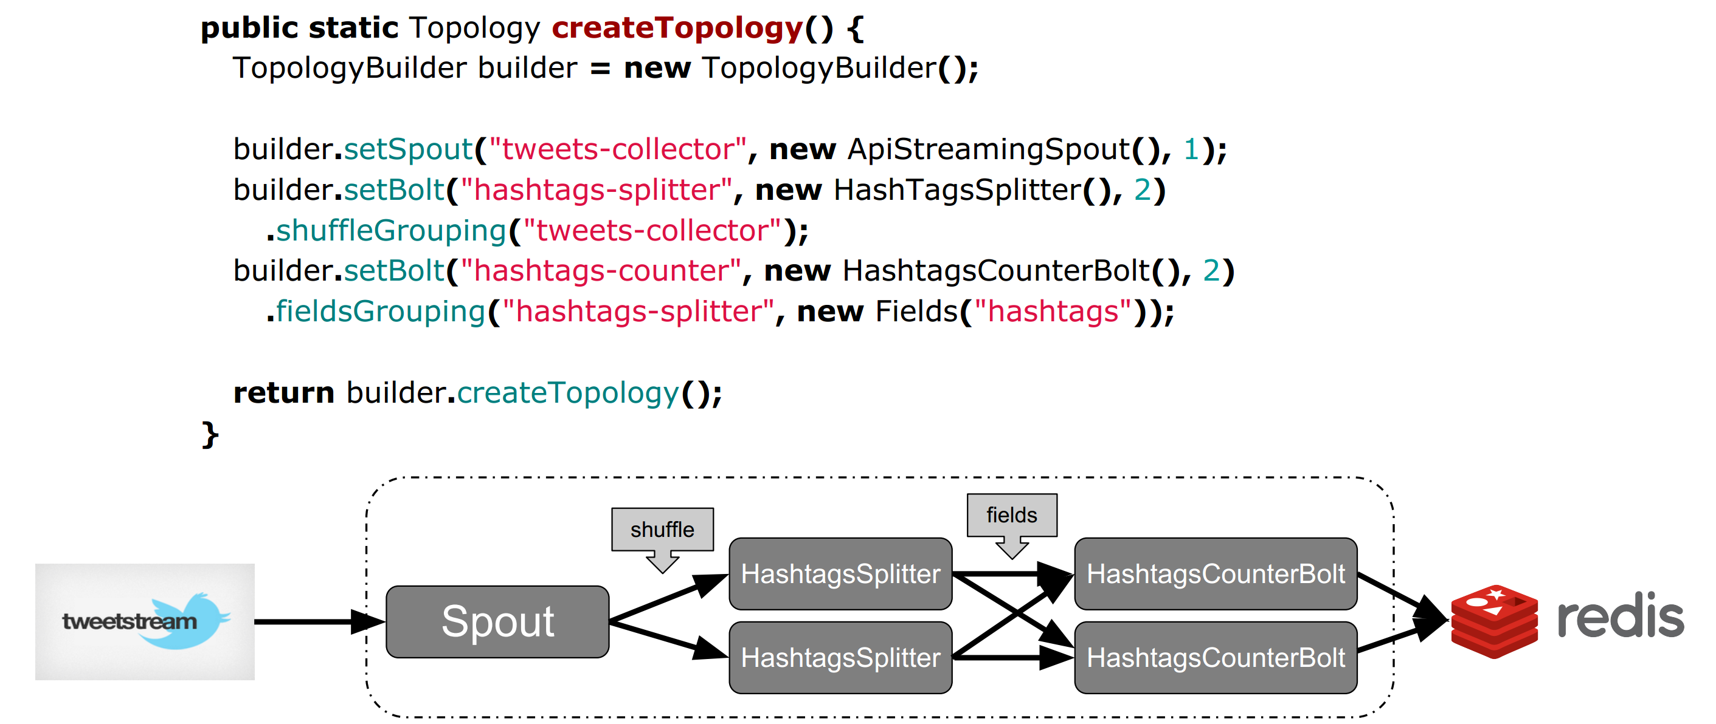
Topology
ShuffleGrouping:
Tuples are randomly
distributed accress all
the tasks running the bolt
FieldsGrouping:
Groups tuples by specific named fields
And routes them to the same tasks
A directed graph of spots and bolts

Slide 19
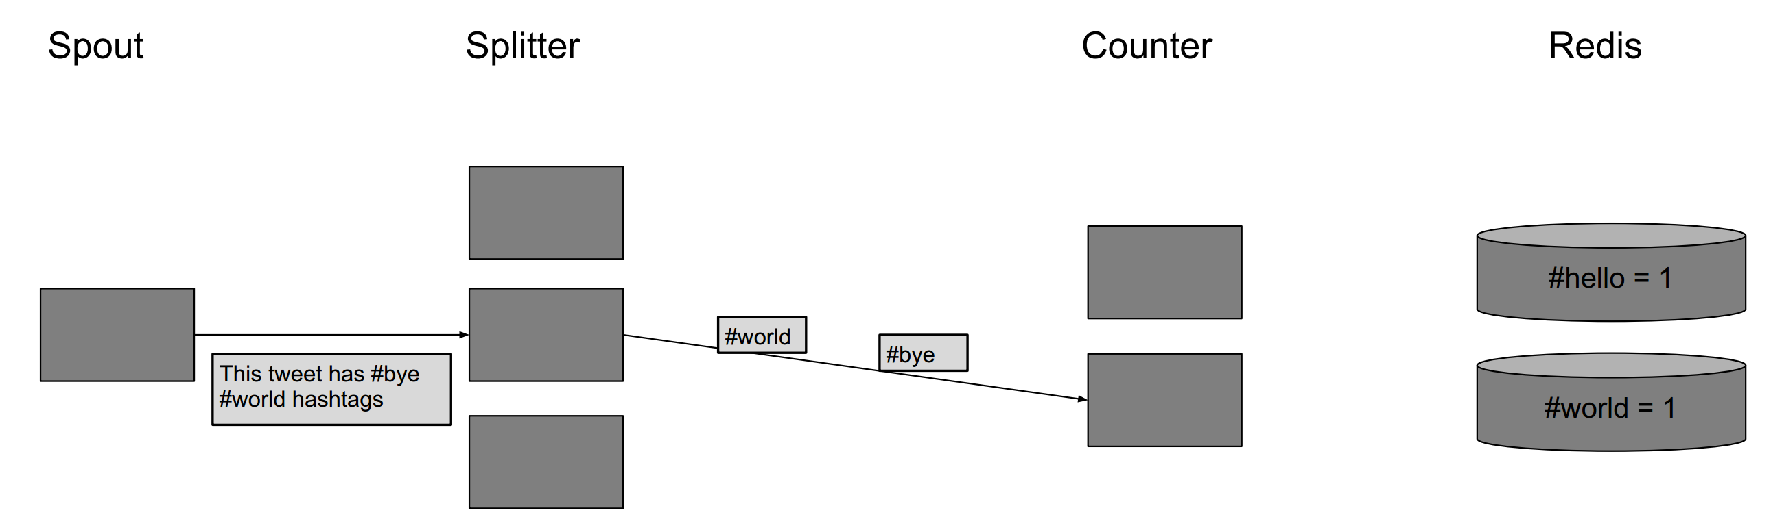
Example

Slide 20
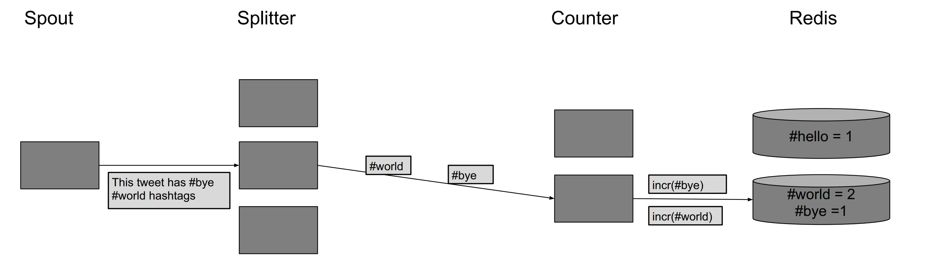
Example

Slide 21

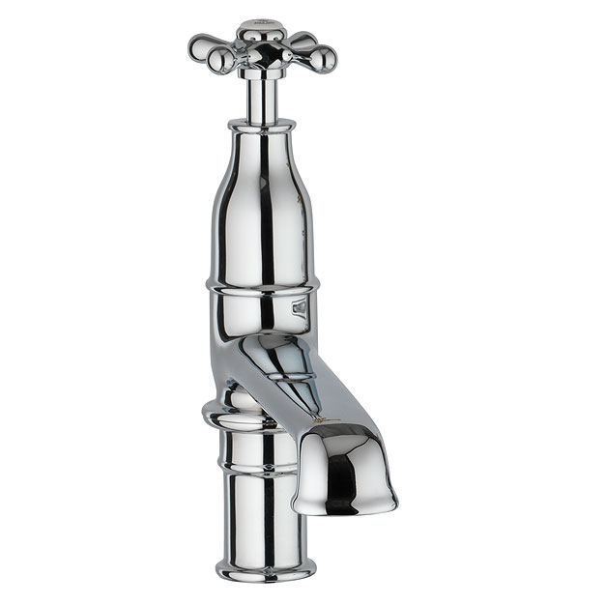
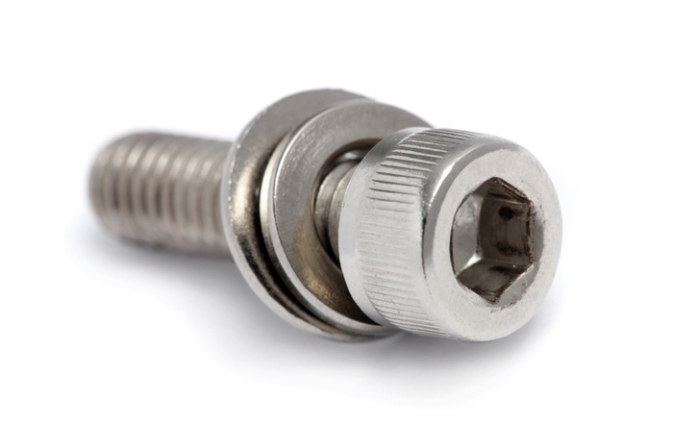
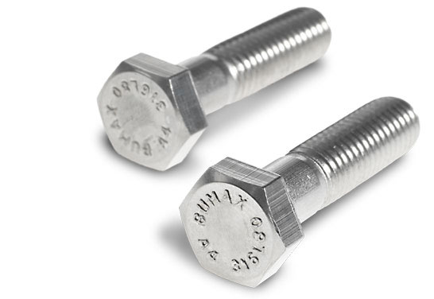

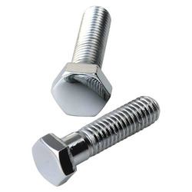
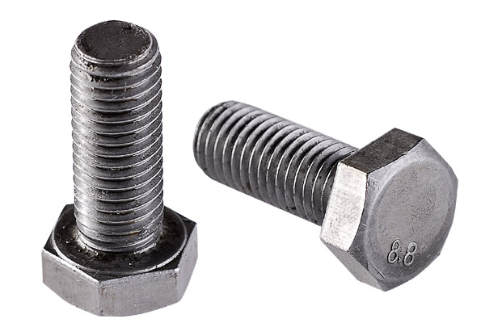
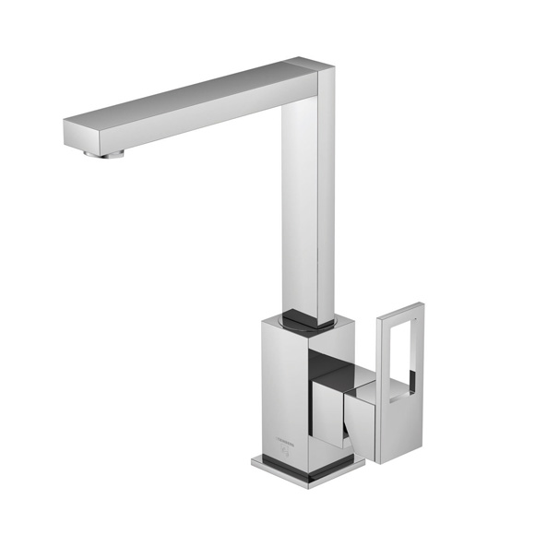
Architecture
topology
bolt
spout

Slide 22
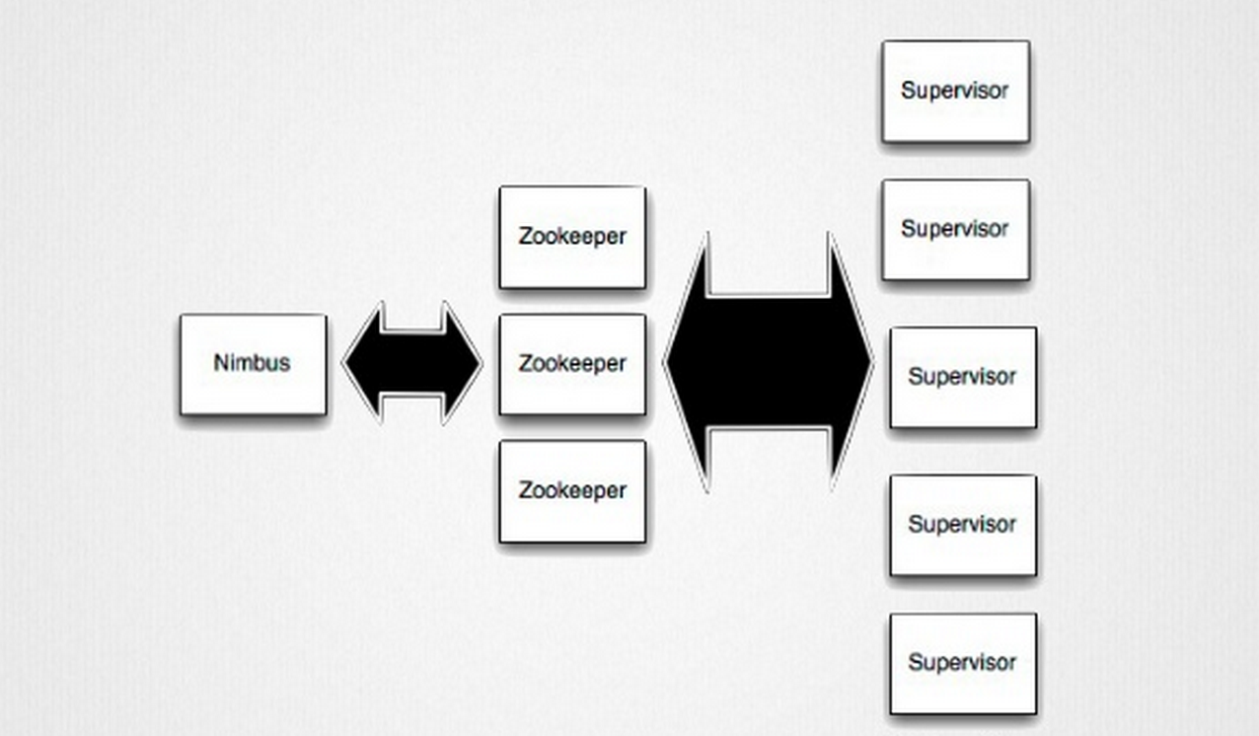
Notes:
Nimbus: Job tracker
Zookeeper: Coordinate everything
Supervisor : Task tracker

Slide 23
Running a Topology

Slide 24


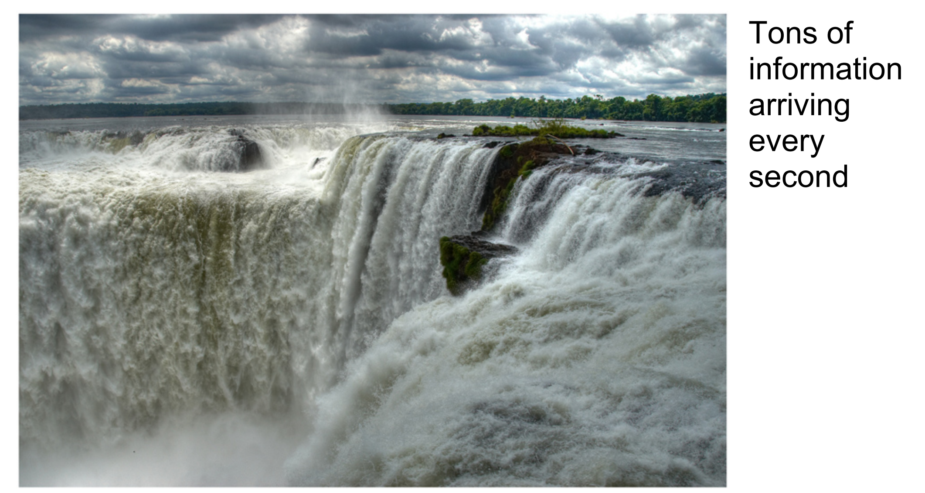
When to apply Storm?
CHALLENGE ACCEPTED!

Slide 25

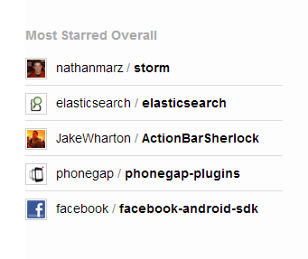
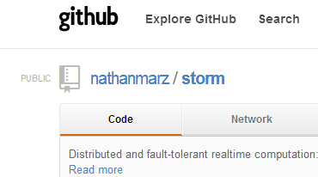
Aktivt miljø
storm-project.net

Slide 26


Sammendrag
Stormby Twitter
jon.espen.ingvaldsen@kantega.no
qadeer.ahmad@kantega.no

